Slide 1
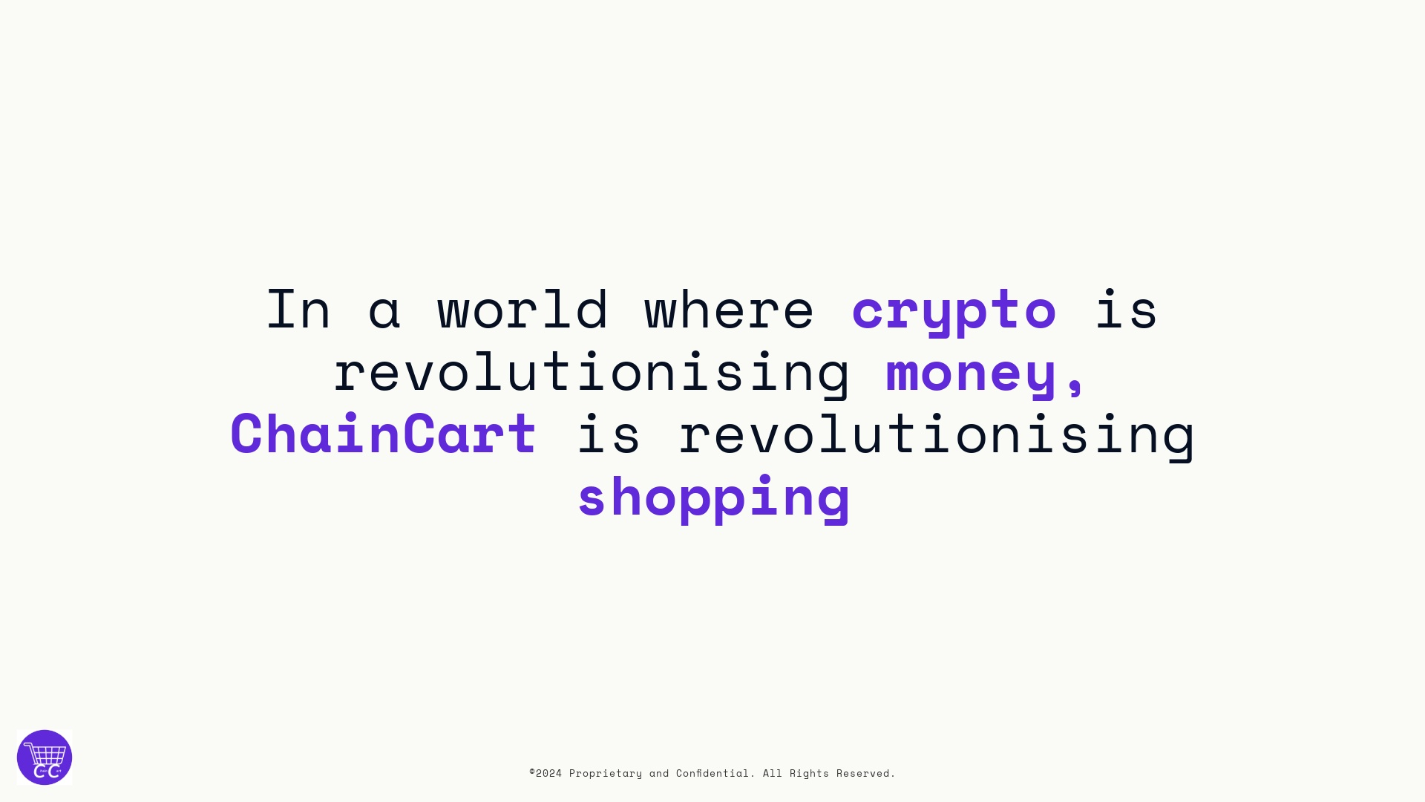

Slide 2
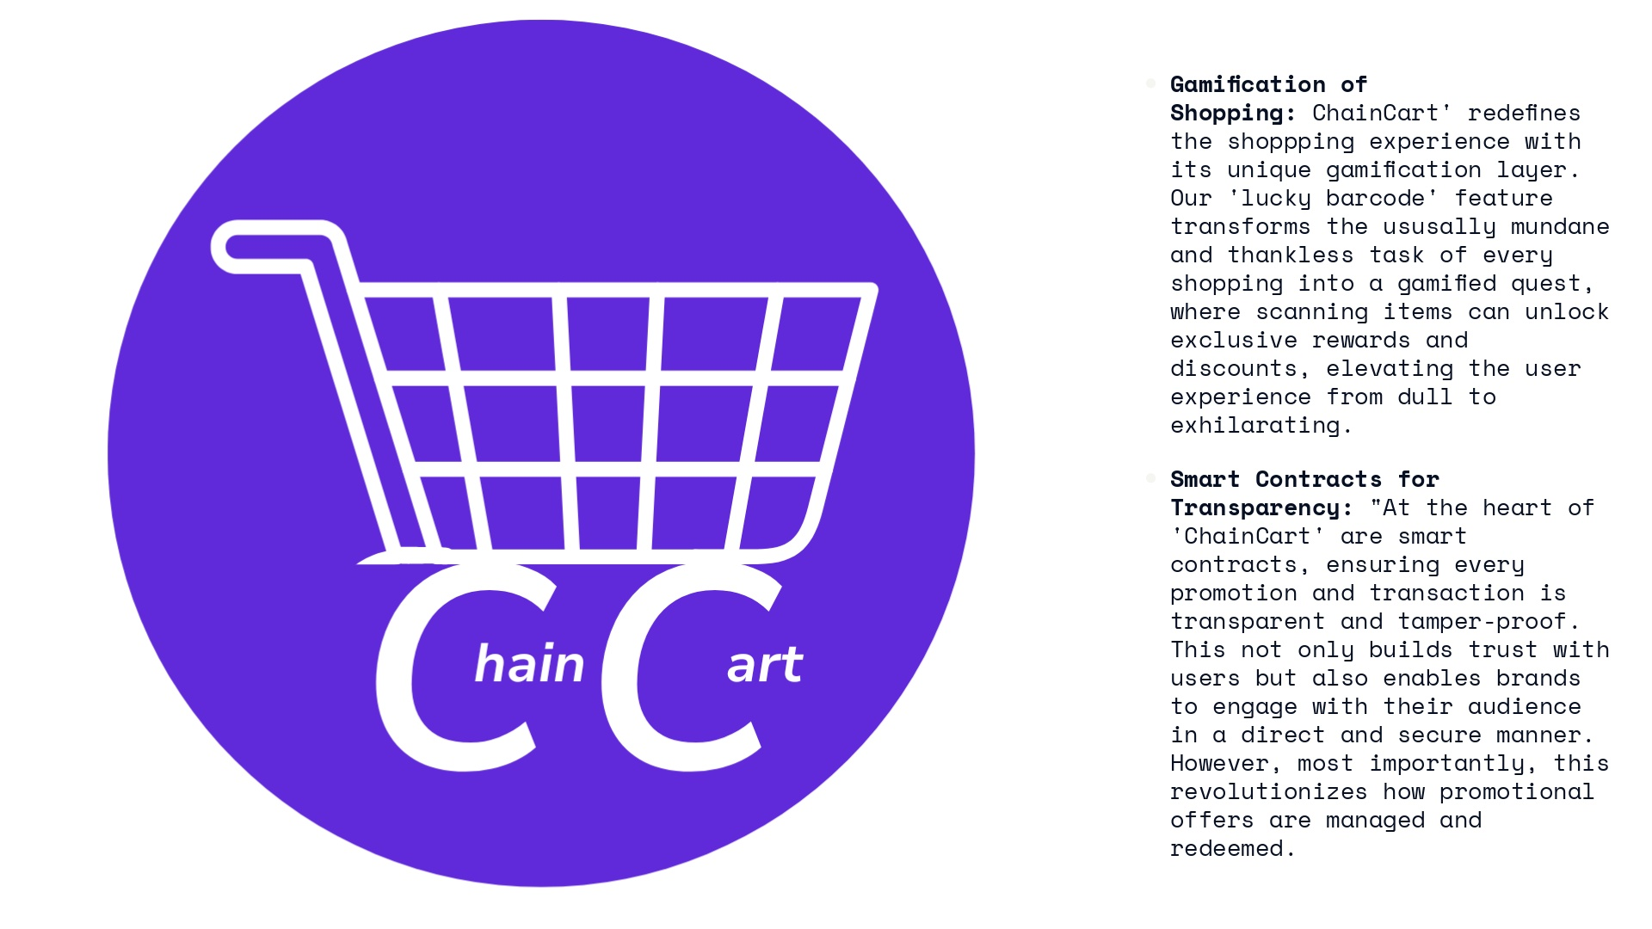

Slide 3

Notes:
Video URL: https://player.vimeo.com/progressive_redirect/playback/581739356/rendition/2160p/file.mp4?loc=external&oauth2_token_id=1747418641&signature=9557b61e07e53b8a98028ee238b8c3d22b3f690adffc826edfec3f976fb4cf90

Slide 4
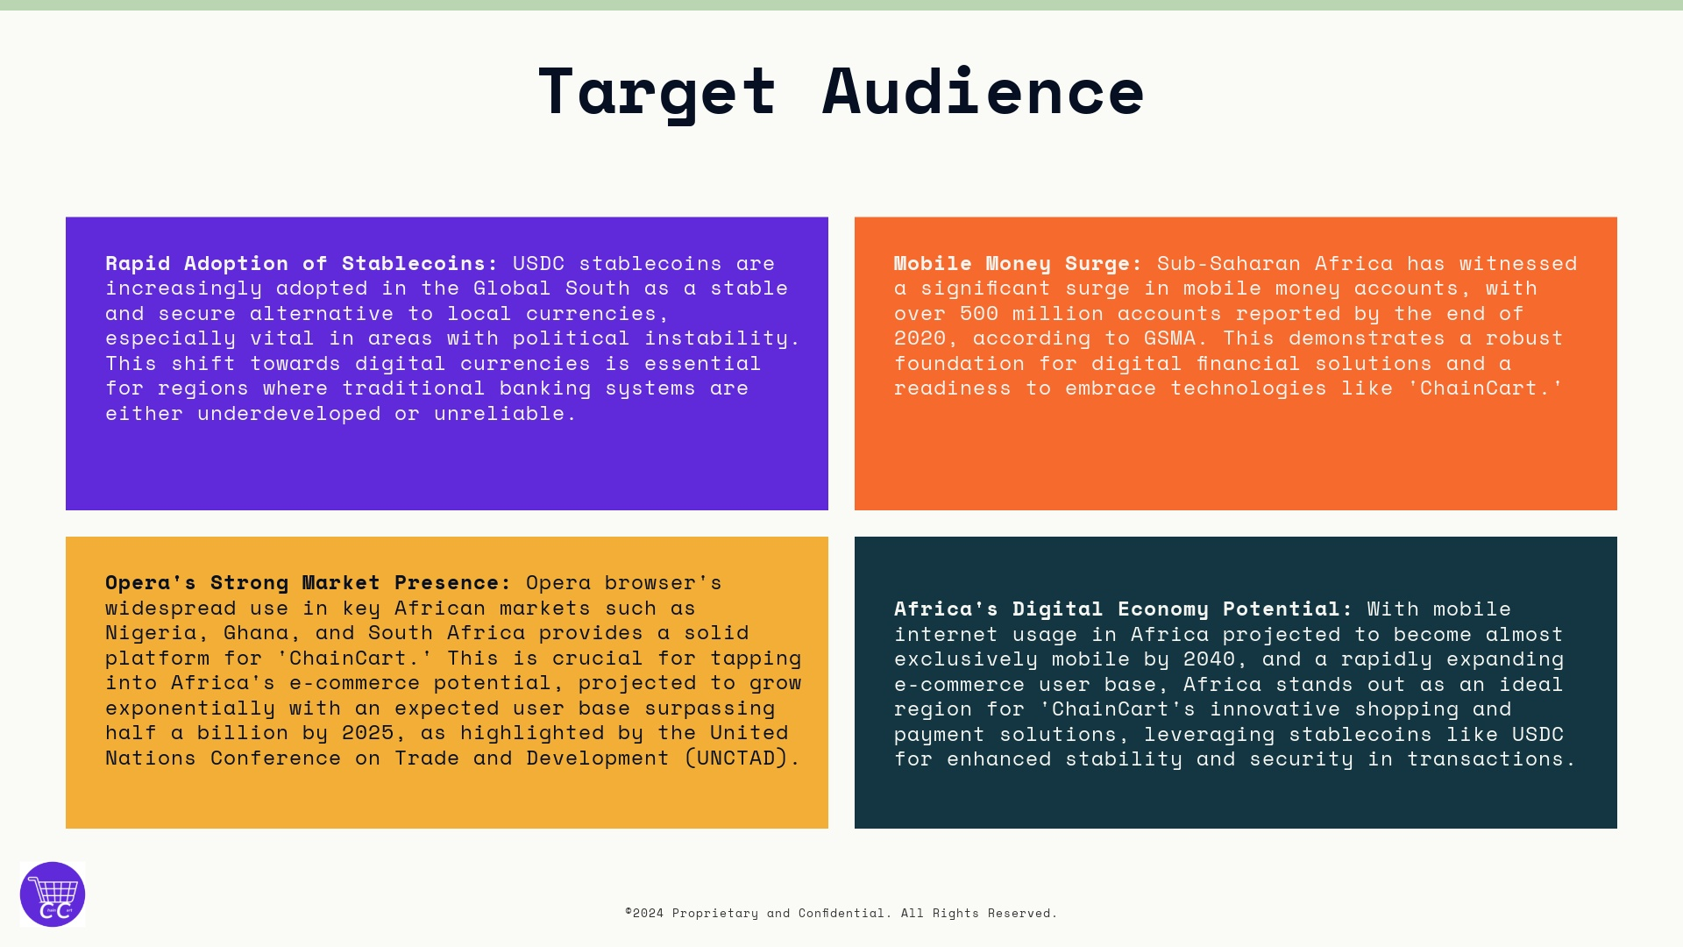

Slide 5
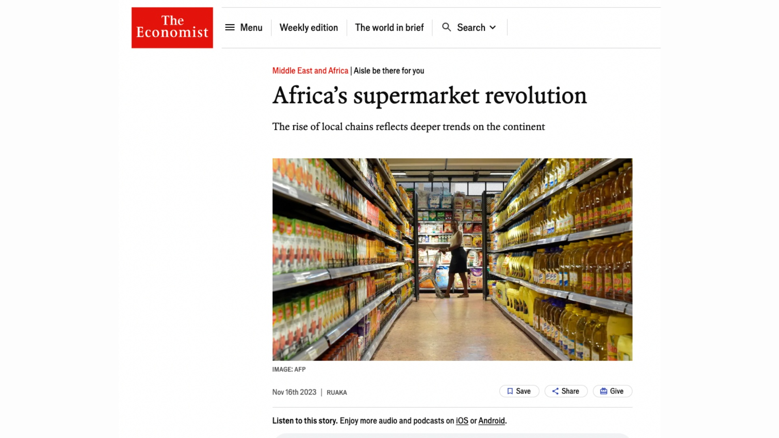

Slide 6
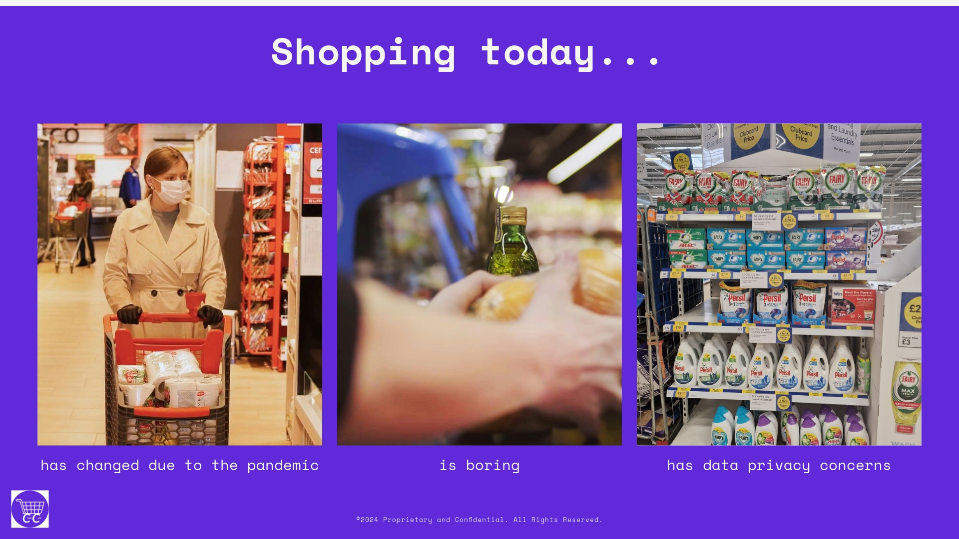
Notes:
Video URL: https://player.vimeo.com/progressive_redirect/playback/414899648/rendition/1080p/file.mp4?loc=external&oauth2_token_id=1747418641&signature=16fedec9b831def28440826ed46d35aee2d34d19a5b5da874ac65fab1495ea93 Video URL: https://player.vimeo.com/progressive_redirect/playback/406132696/rendition/2160p/file.mp4?loc=external&oauth2_token_id=1747418641&signature=a9c8ae76e7ff46068e715749f2f509922306a5328b652d6f7012010282e62931

Slide 7
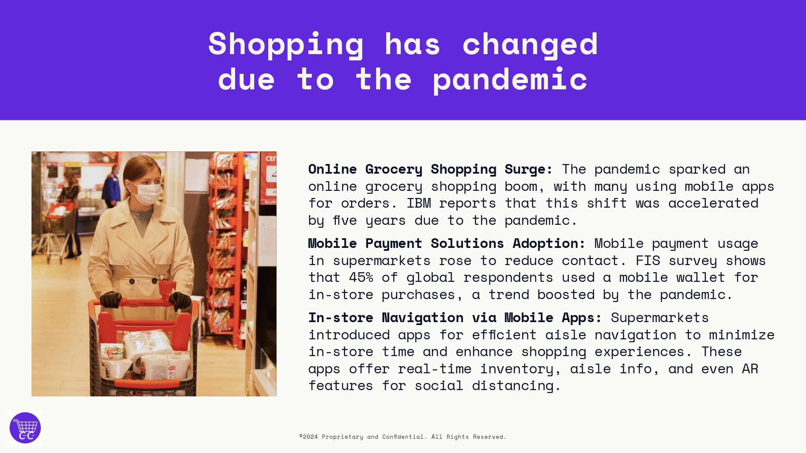
Notes:
Video URL: https://player.vimeo.com/progressive_redirect/playback/414899648/rendition/1080p/file.mp4?loc=external&oauth2_token_id=1747418641&signature=16fedec9b831def28440826ed46d35aee2d34d19a5b5da874ac65fab1495ea93

Slide 8
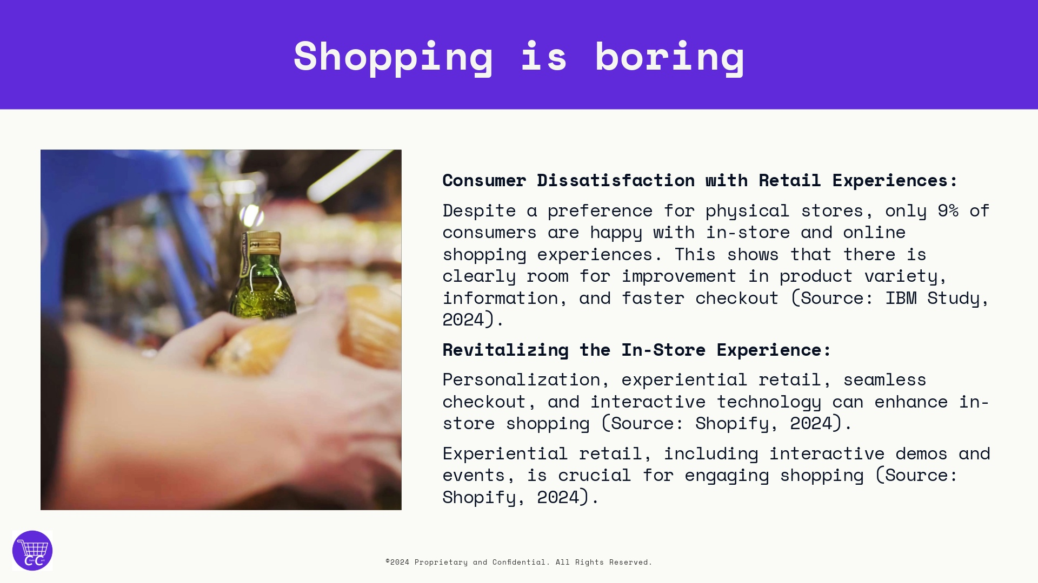
Notes:
Video URL: https://player.vimeo.com/progressive_redirect/playback/406132696/rendition/2160p/file.mp4?loc=external&oauth2_token_id=1747418641&signature=a9c8ae76e7ff46068e715749f2f509922306a5328b652d6f7012010282e62931

Slide 9
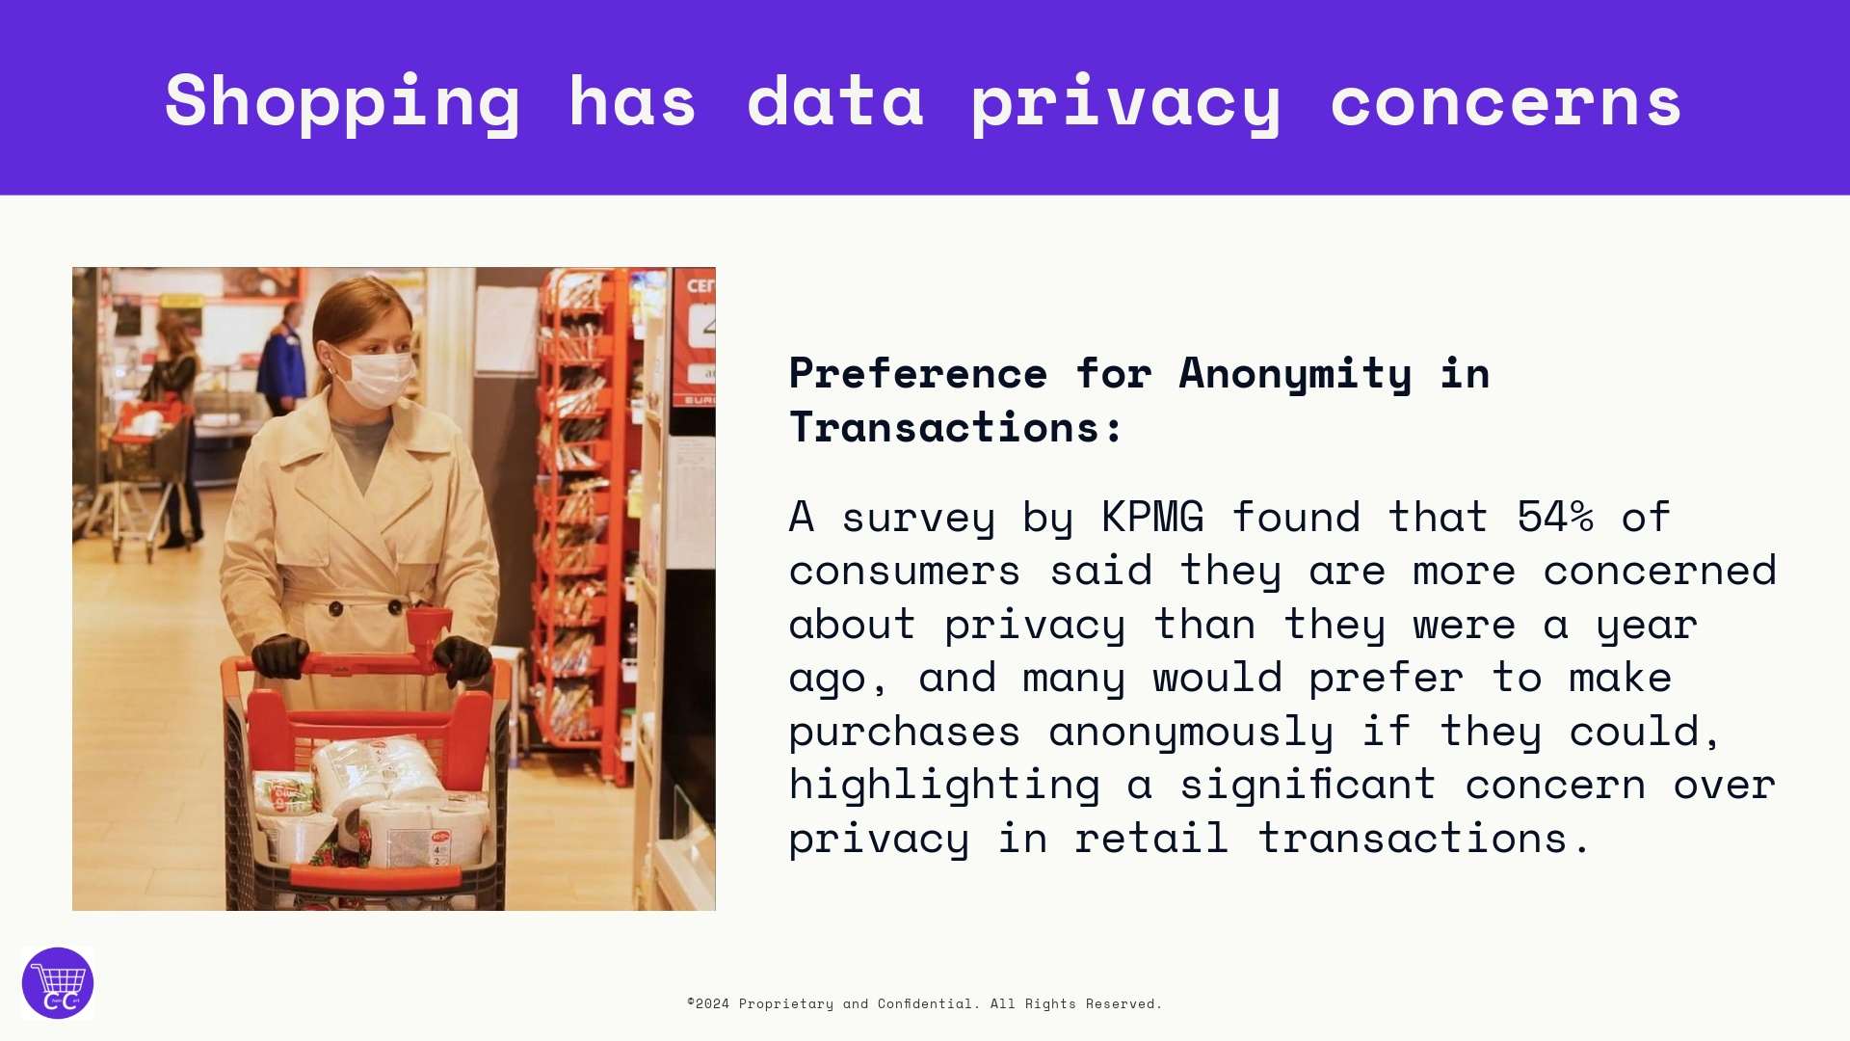
Notes:
Video URL: https://player.vimeo.com/progressive_redirect/playback/414899648/rendition/1080p/file.mp4?loc=external&oauth2_token_id=1747418641&signature=16fedec9b831def28440826ed46d35aee2d34d19a5b5da874ac65fab1495ea93

Slide 10
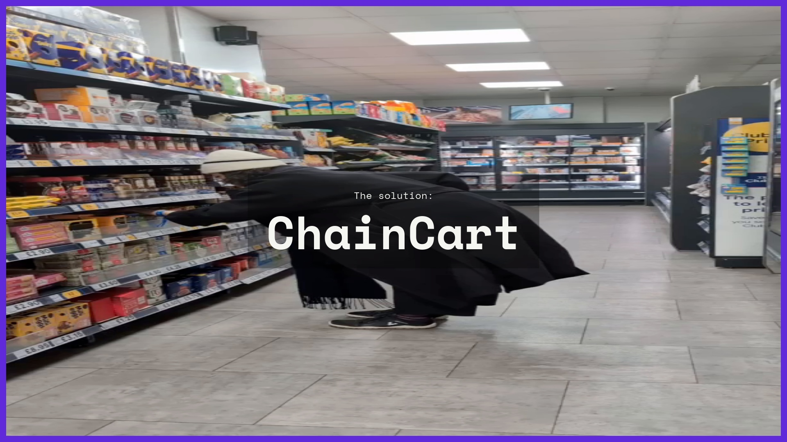
Notes:
"ChainCart" as a seamless, secure, and engaging shopping solution that operates within the Opera Mini browser, leveraging the power of Web3 technologies.

Slide 11
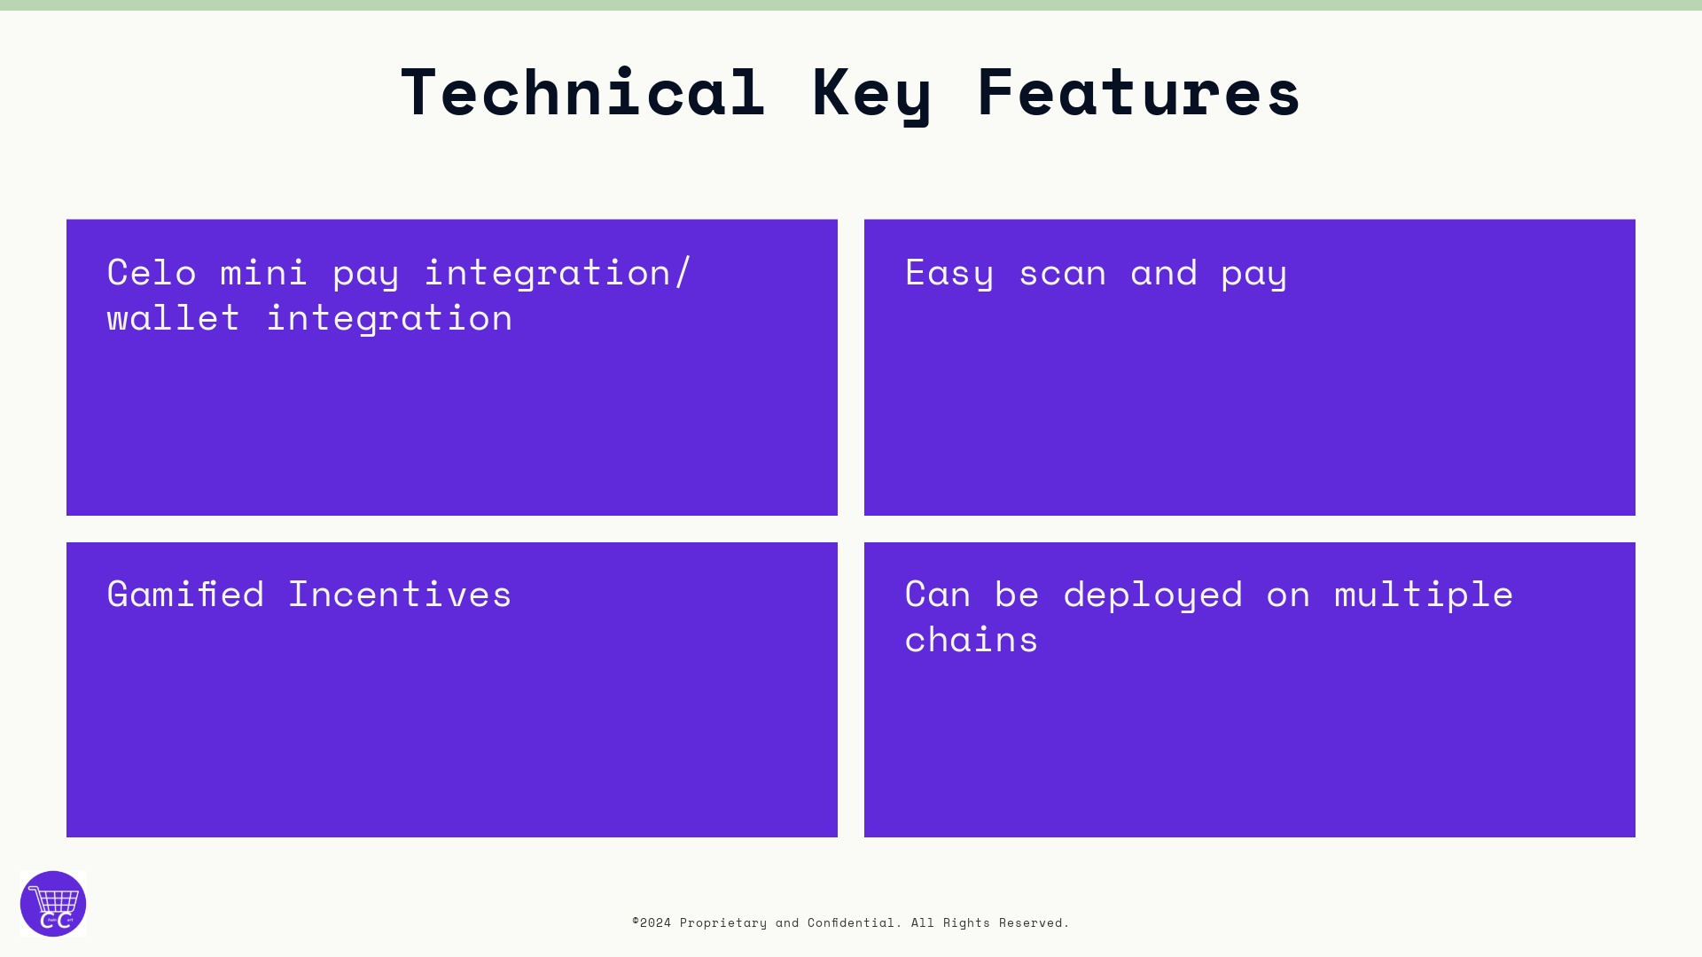

Slide 12
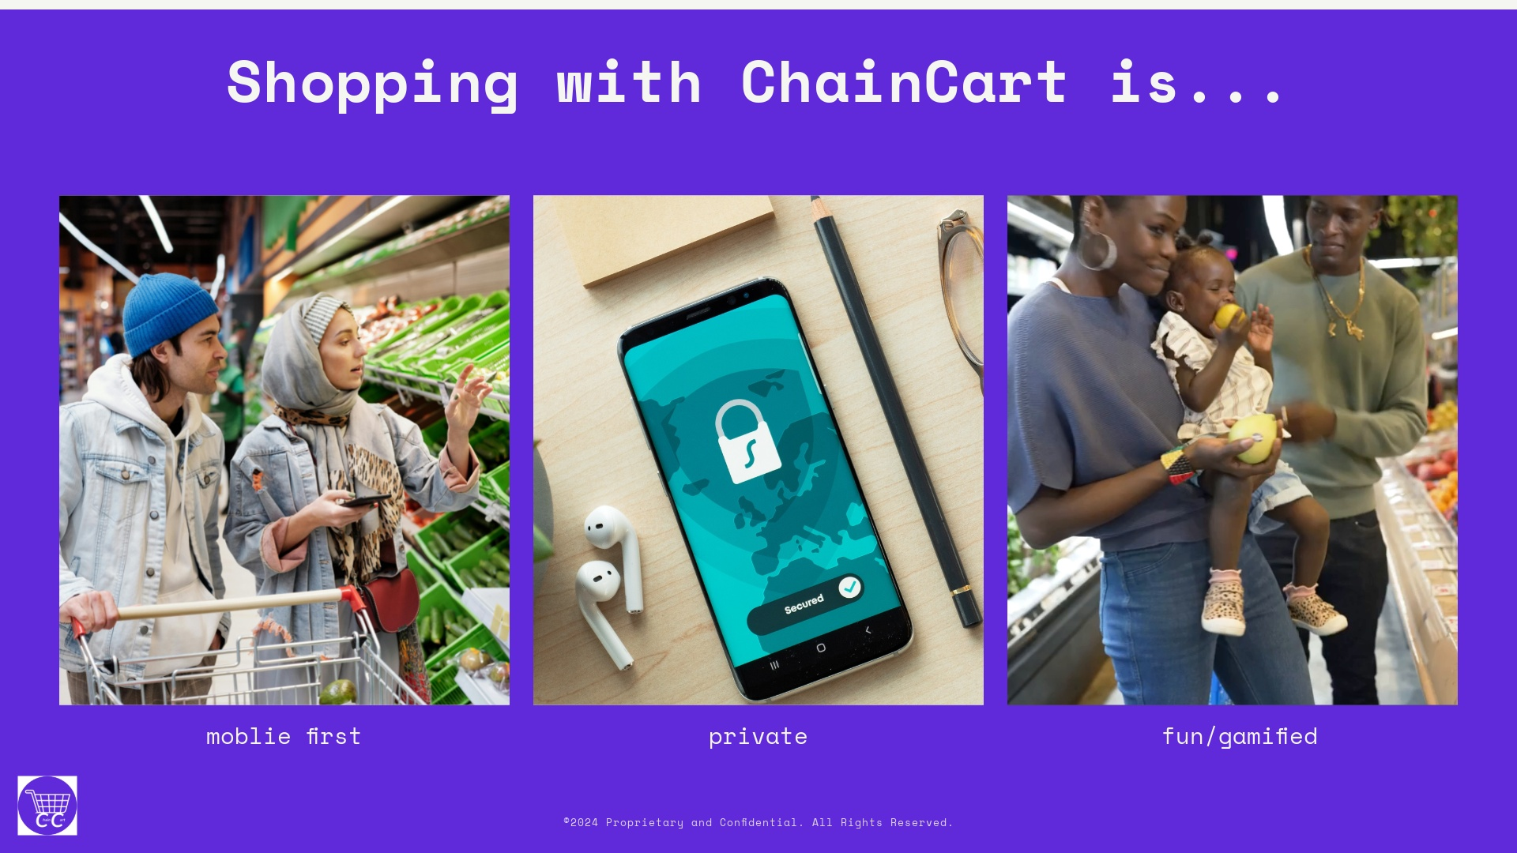

Slide 13
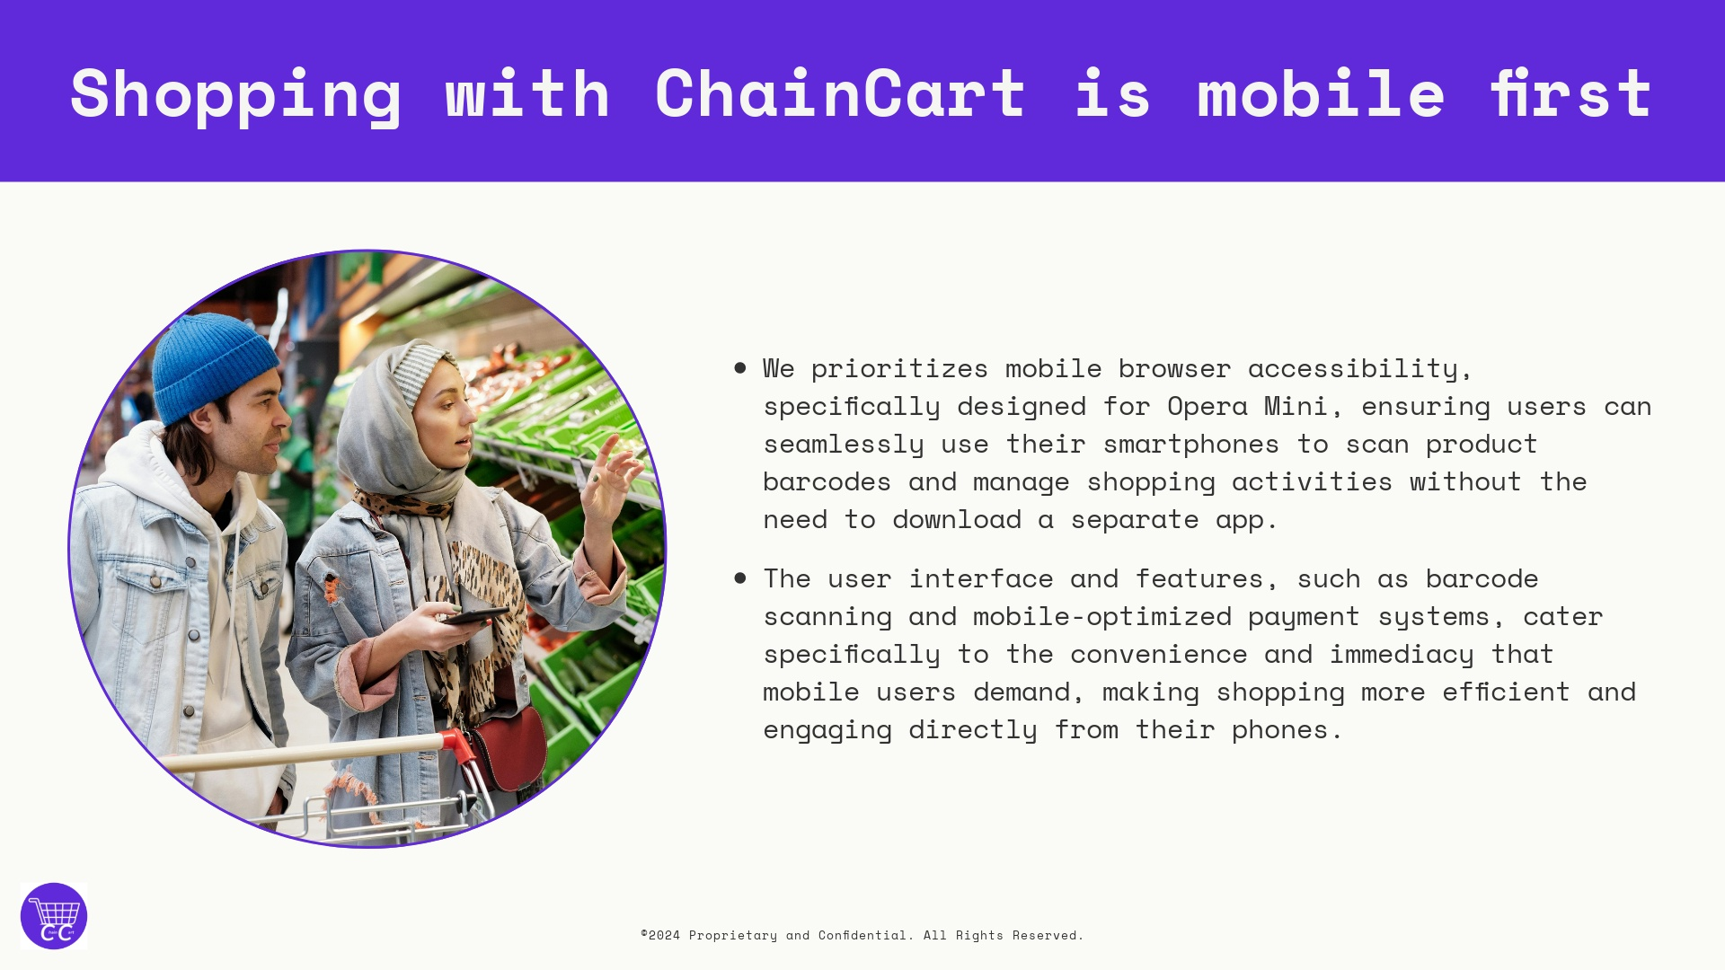

Slide 14
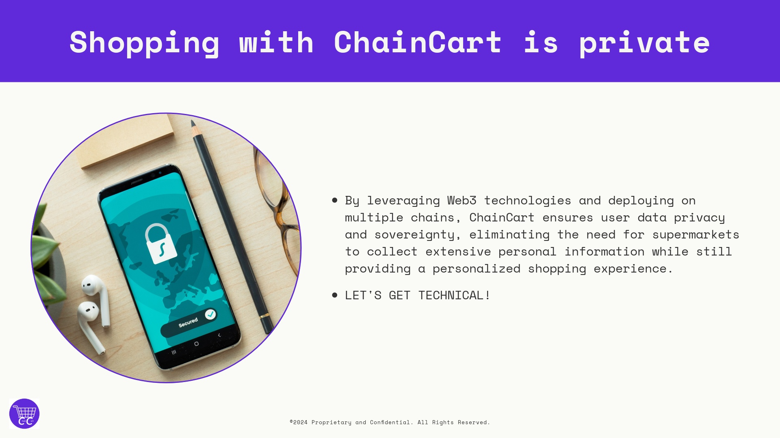

Slide 15
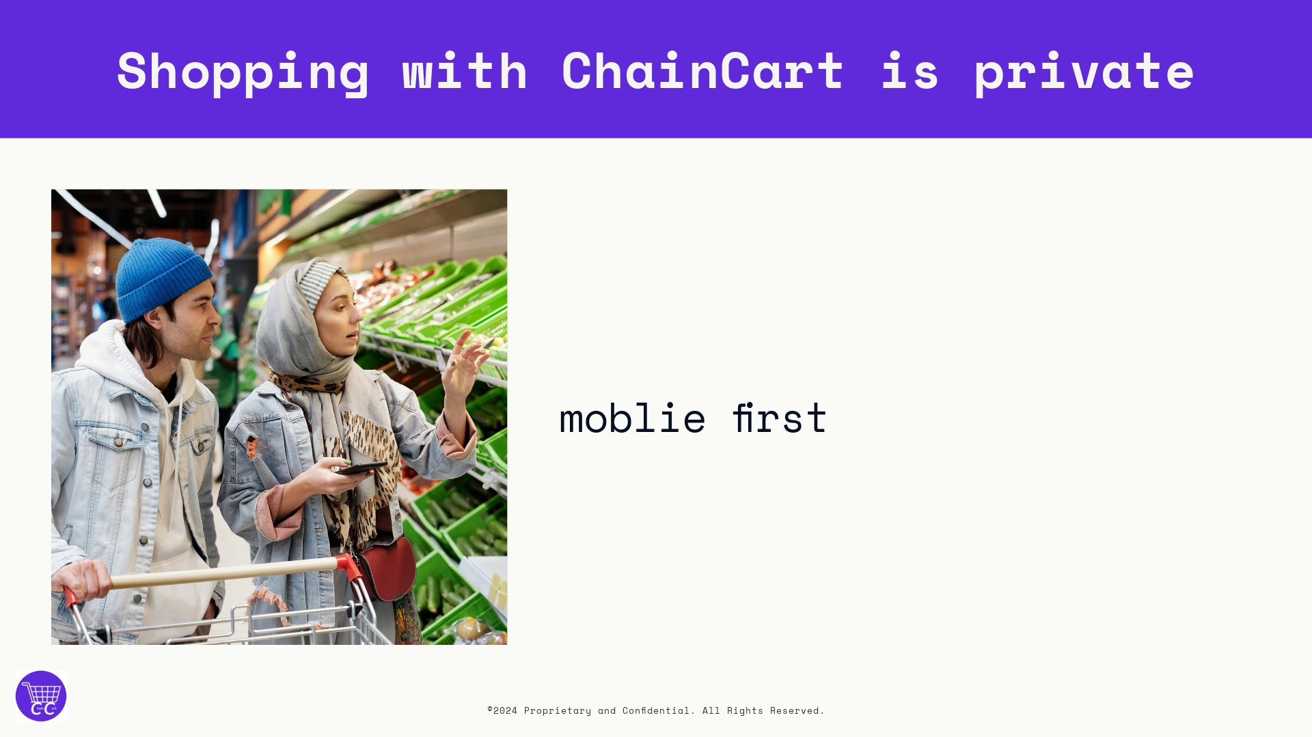

Slide 17
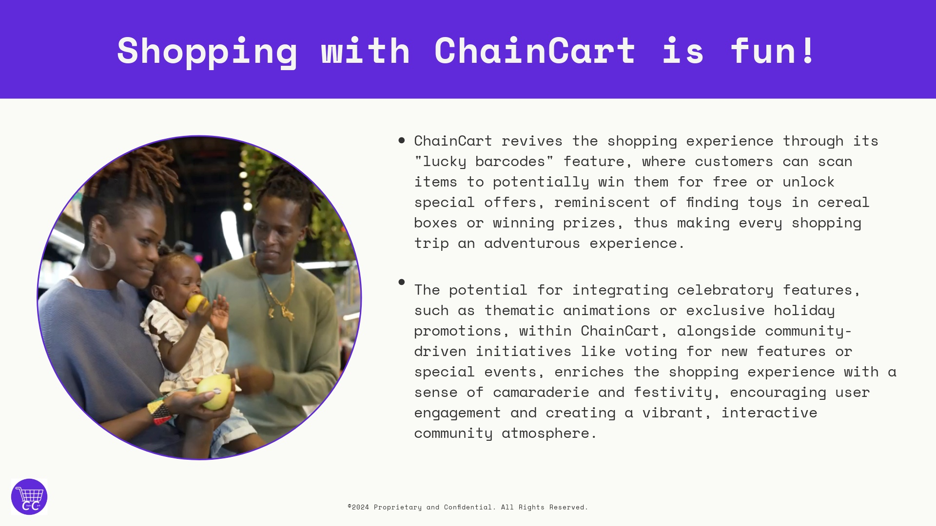

Slide 18
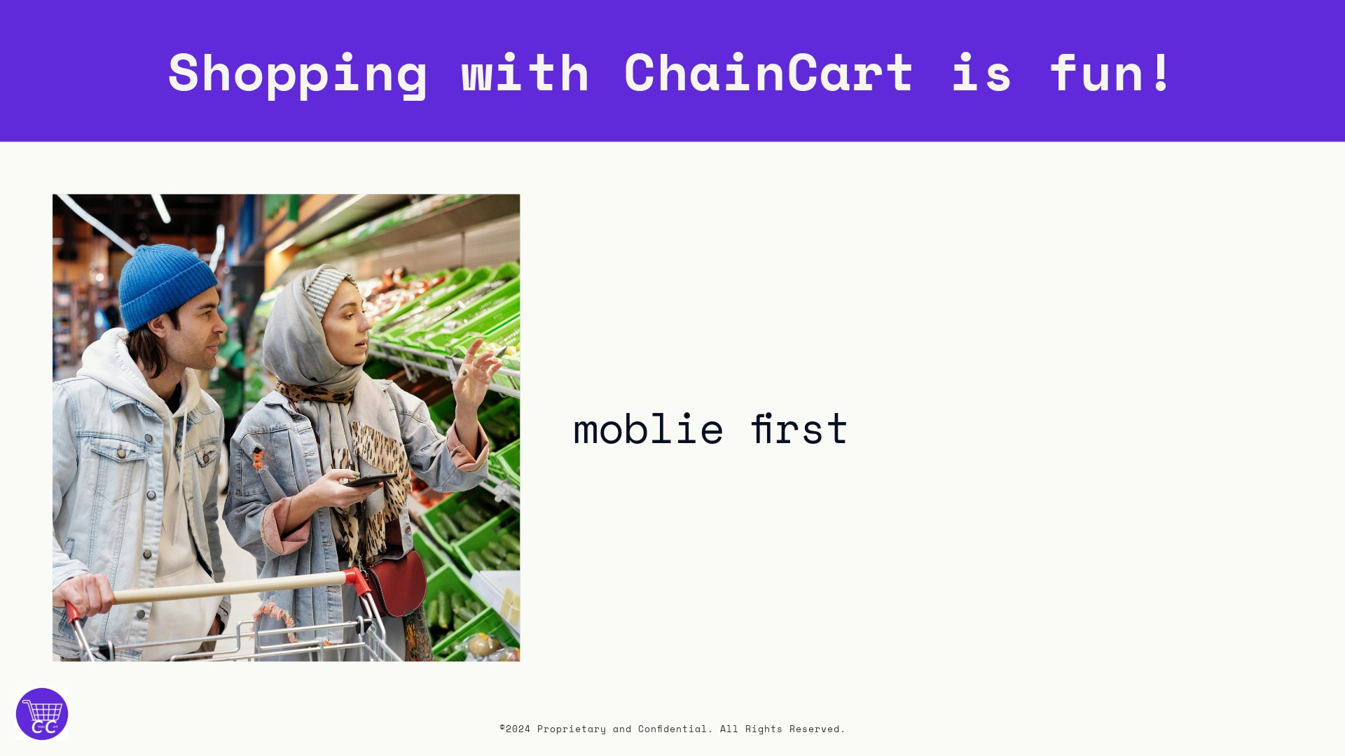

Slide 20
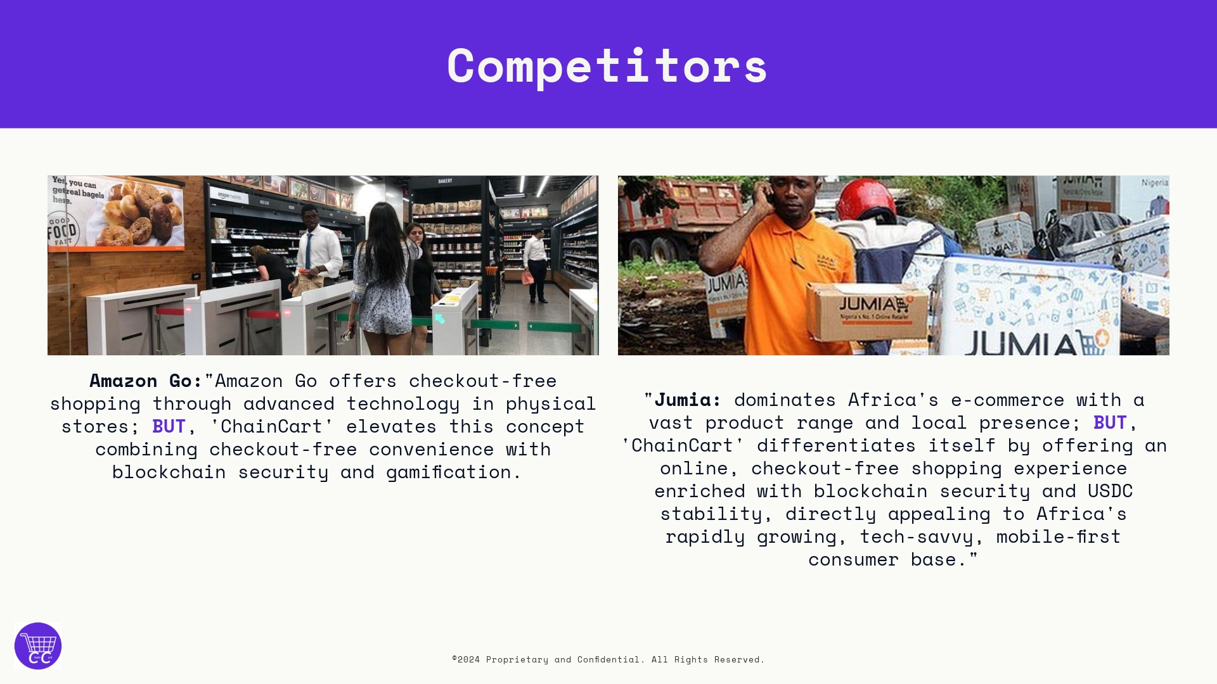

Slide 21


Slide 22
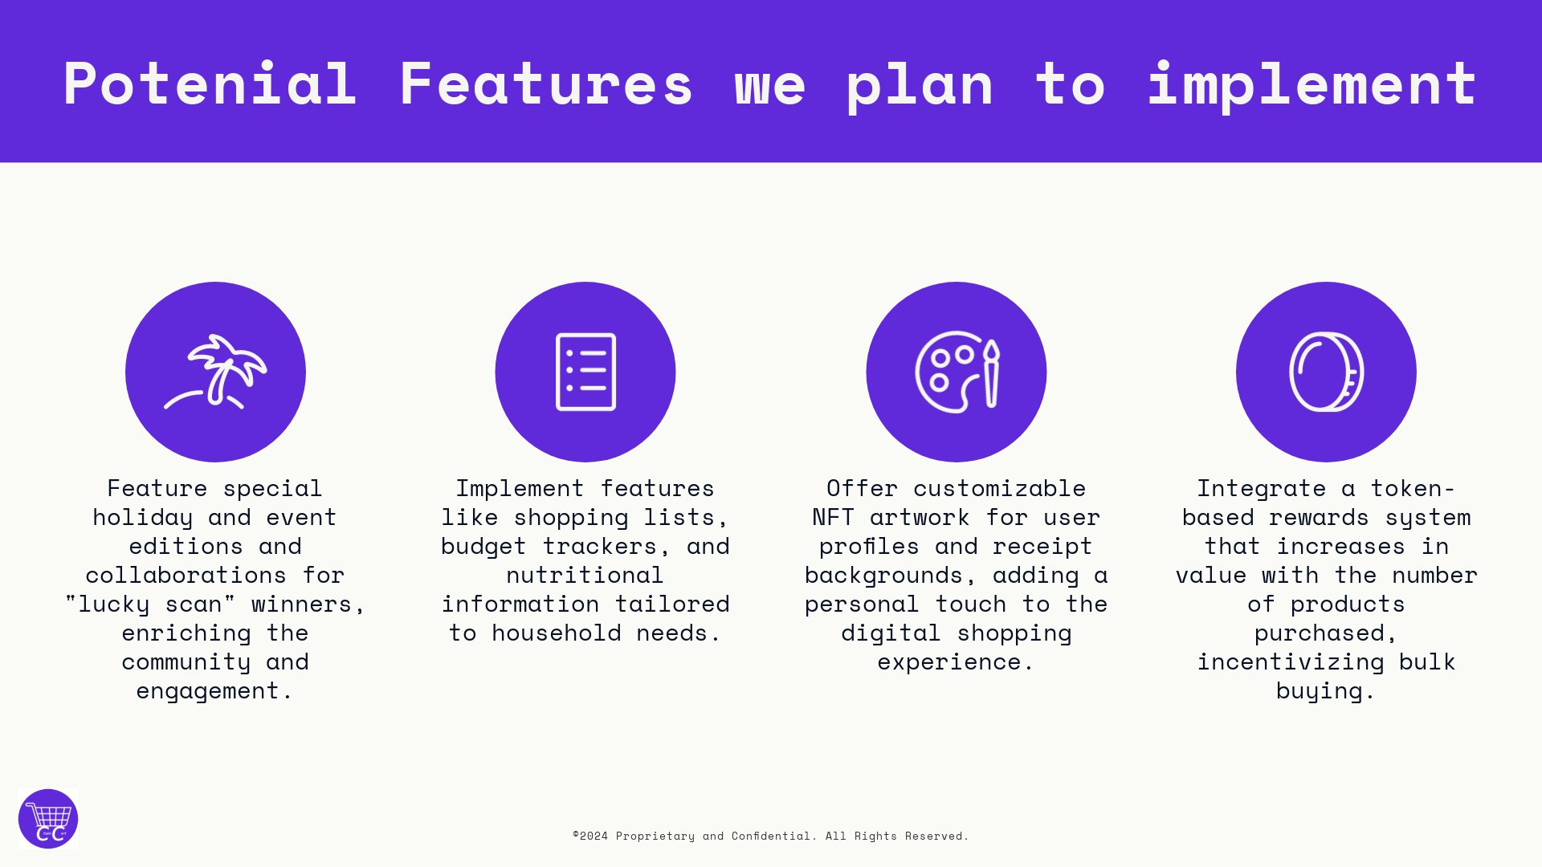

Slide 23
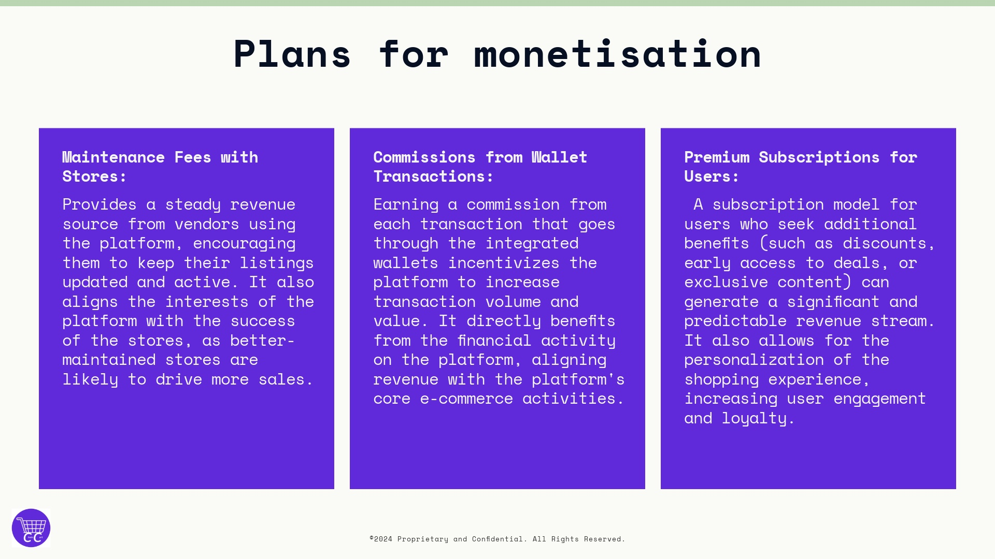

Slide 24
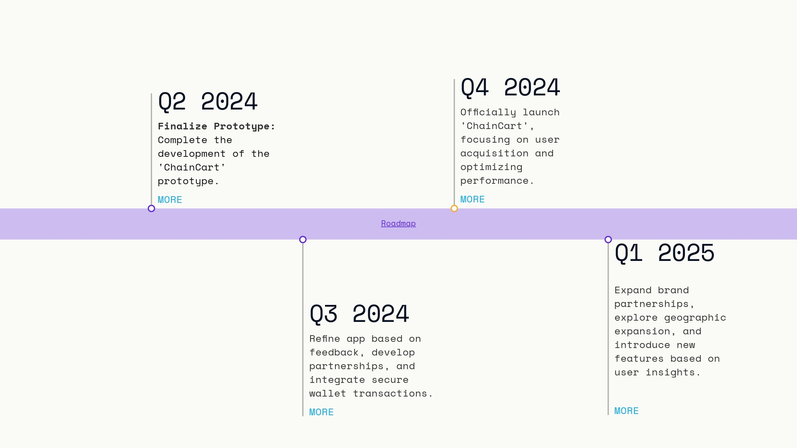

Slide 25
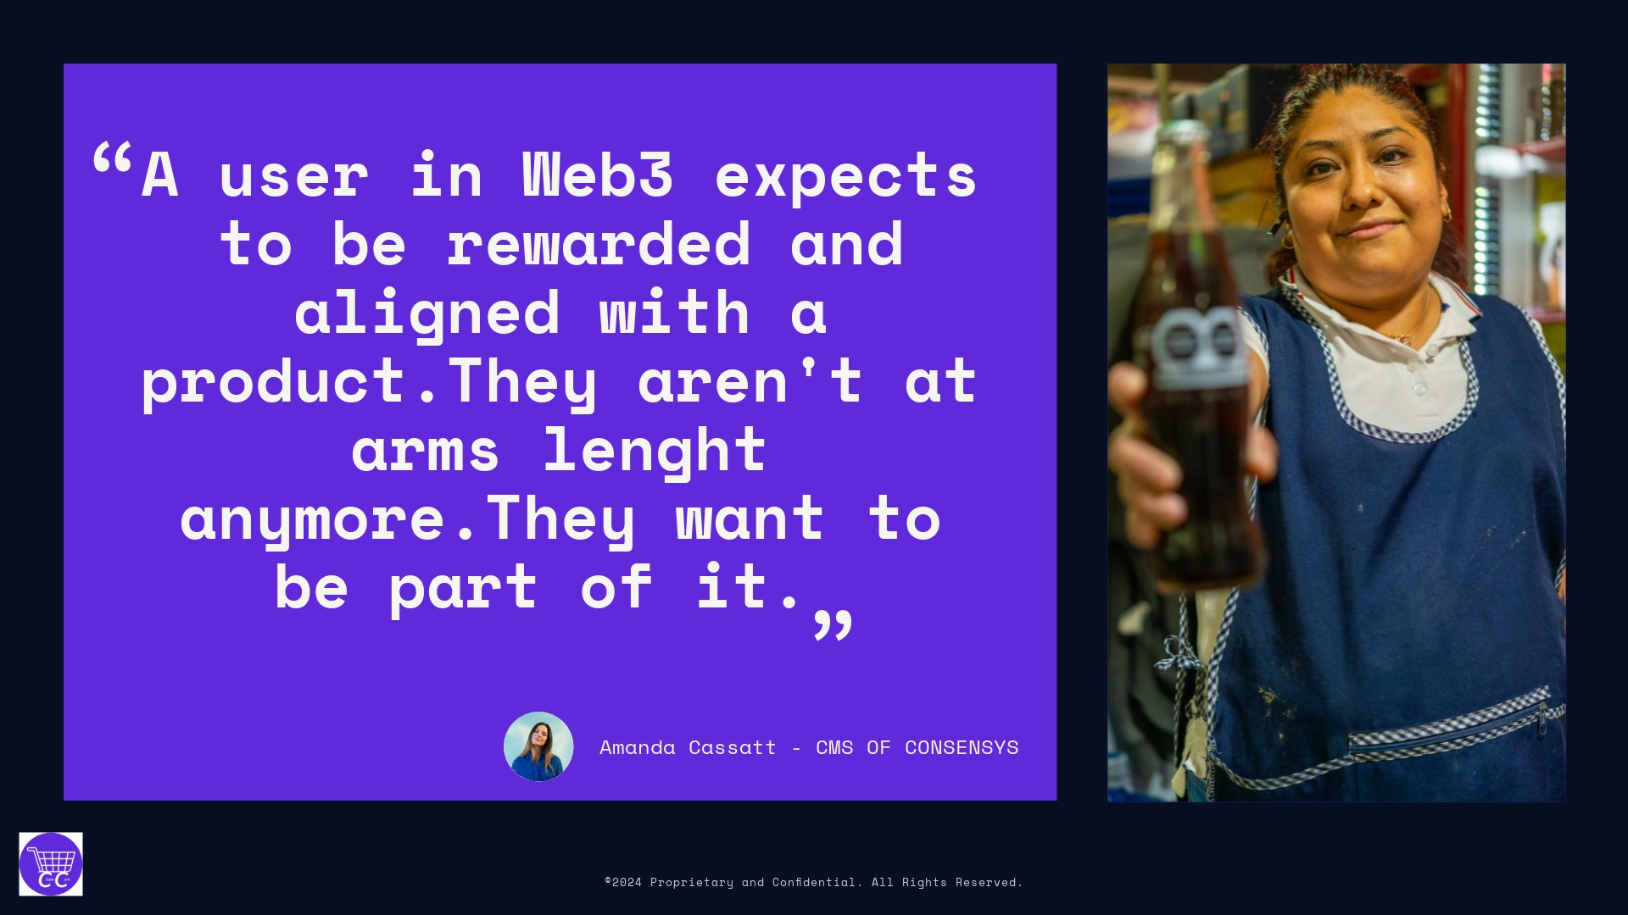
Notes:
njksnvksncskjcfskcfnskjvb skh

Slide 26


